Slide 1







Database Layer
Functional Layer
Appearance Layer
UserDB
Permanent DB of users. Vehicle details are stored and are referenced against the CarDB and NewFaultDB.
Keys: userID, email, VIN
Fields:
Vehicle Make
Vehicle Model
Year of Manufacture
VIN
Name
Email
Password (encrypted)
Front-End
A simple web-based GUI, that allows for the following user interactions (and their outputs):
Create User Profile
Log in
Search Functionality
Register Details for Updates
function CreateUserProfile:
Input name, email address, password (encrypted) to create profile and interact with the application as a user.
Database Interaction: UserDB
function Login:
Input email, password to log back in to the application as a user.
function RegisterForUpdates:
Once CreateUserLogin is created, user can input Make, Model, Manufacture Year, VIN to register details and be updated
Database Interaction: UserDB, CarDB
function SearchDataBase:
Search CarDB by Vehicle Name, Make, Model, VIN, Fault Type to generally query outstanding vehicle faults
Database Interaction: CarDB
Inputs | Operations | Outputs
Prompt User for name, email, password | Verify user (email user with verification link) Once verified, create new user in userDB | New User Profile Created
CarDB
Permanent database for the storage of vehicle make, model, specifics of fault. Updated regularly by newFaultDB
Key: VIN
Fields:
Vehicle Make
Vehicle Model
Year of Manufacture
VIN
Date of Fault Discovered
Date of Fault Resolved
Bool currentFault
faultDescription
faultResolution
Back-End
Inputs | Operations | Outputs
Prompt User for email, password | Check input against UserDB, if valid, OK | User logs back in to application
function VerifyUserID(UserDB.email):
Once CreateUserLogin is created, verify email address by sending email to nominated address. New User is not validated until this is confirmed.
Database Interaction: UserDB(email)
function ScanDB(RegisterForUpdates, SearchDataBase):
For all RegisterForUpdates objects in the application, automatically scan the CarDB database daily to check if there are any active faults that correspond to the user’s DB.
Database Interaction: Comparing UserDB(VIN) with
CarDB AND NewFaultDB(VIN, currentFault = True)
function AddNewUserToDB(CreateUserLogin):
Once CreateUserLogin is created, update UserDB
Database Interaction: UserDB
function EmailUserFaults(RegisterForUpdates):
If ScanDB runs and there is a current fault for user X, email user X with specifications of the fault.
Database Interaction: UserDB(email)
function UpdateCarDB(***parse external data from car companies***):
Receive input data from car manufacturers, including Make, Model, Manufacture Year, VINs affected, Fault Date of Discovery, Fault Description, Fault Resolution. Collect in NewFaultDB, then transfer periodically to CarDB
Database Interaction: NewFaultDB, CarDB
Inputs | Operations | Outputs
Prompt User to input make, model, VIN, fault type | User’s input is applied to the SearchDataBase function to scan the CarDB for matching criteria | User is output with search results
NewFaultDB
Transient database that is populated on daily basis after scanning for new vehicle faults. Records in NewFaultDB (if any) are added to CarCB daily. Fields:
Same as CarDB
Inputs | Operations | Outputs
Prompt existing User to add make, model, VIN to their profile | User’s vehicle data is used as an input in the ScanDB function and checked against any corresponding faults in the CarDB. | User is emailed if there is a matching fault with their registered vehicle

Slide 2
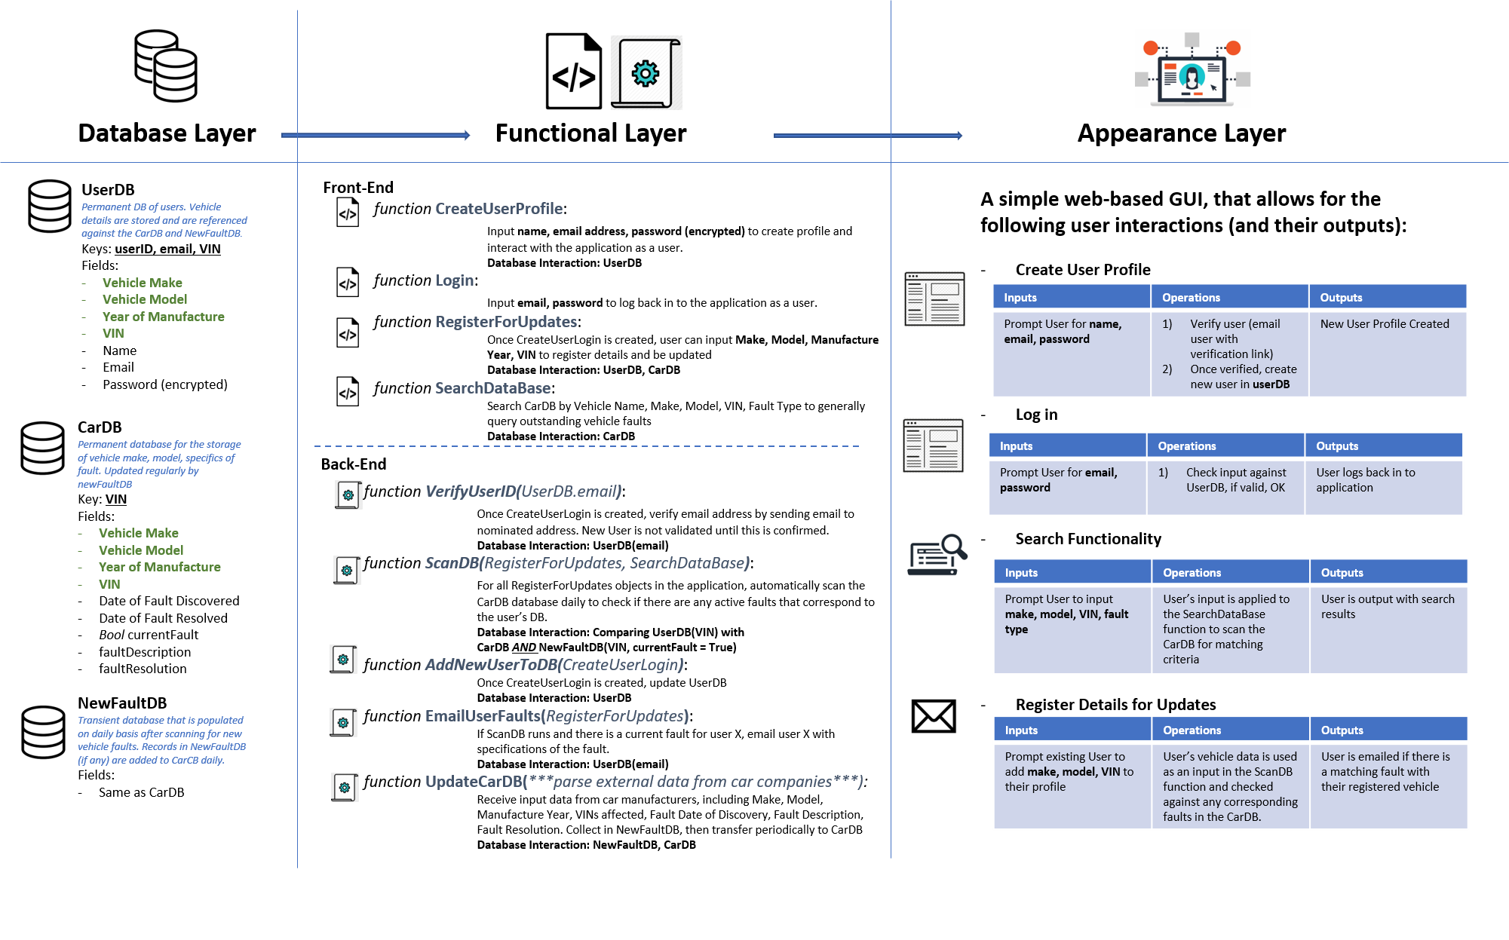
Role Breakdown:
Team Member | Roles & Responsibilities
Chris Bounsall | Frontend Developer
Francois Smit
Harpreet Bhangu (Sunny) | Backend Developer
Matthew Yearbury (Matt) | Junior Security Analyst
Ryan Gallagher | Scrum Master / Backend
Vu Anh Duy NGUYEN
Application & Data Security: Matt
Web Backend: Chris
Infrastructure: Sunny
Backend: Sunny & Ryan
Web Front-End: Vu

Slide 3
Sprint Planning Overview
Sprint 1 (2 weeks) Objectives:
All Roles & Responsibilities Established
Each user with defined requirements
Data Removed from Spreadsheets
Move data from spreadsheets to new DBs
Application Infrastructure Established
Architecture requirements are finalised
Website design finalised and user-tested
Layout, UX/UI complete
Tested (without actual functionality) as a prototype
Website front-end functionality complete
Website buttons, site-map etc, work (without back-end functionality)
3x Secure independent DBs established
Cloud-hosted
Data successfully and securely transferred to hosted DBs
Data transferred from spreadsheets, and stored in carDB
Sprint 2 (2 weeks) Objectives:
Backend functionality complete and interacting with DBs
Search functionality to databases
User’s car details being parsed against car DBs automatically
If user’s car shows fault, automatic email delivery to user
Users can create logins
Users can register vehicle
Application automatically updating databases from input received from car manufacturers.
Web backend complete and interacting with GUI and frontend
When user uses a search form, this leads to the search section of the website
When user tries to log in, this leads them to their user profile
User can register details via form
Web backend interacting with application backend
When user inputs data and requests some sort of functionality (such as create account), this feeds through to web backend > user profile is created > user is verified > user details stored in userDB
Platform is secure and data security has been stress-tested

Slide 4
Sprint 1
Sprint 1 (2 weeks) Work Breakdown Structure
Task 1: | Responsibility | Requirements
Collect Data from Spreadsheets | Sunny
Establish 3 x Secure Cloud-Hosted Database Structures | Sunny
Create carDB, userDB and newFaultDB databases | Sunny/Ryan
Transfer Data from Spreadsheets to carDB | Sunny
Stress-Test DB Security | Matt
Task 2: | Responsibility | Requirements
Design UX/UI for Website, Build Prototype | Chris
Build Front-End Functionality for Website | Chris
Test UX/UI user flow | Ryan
Test Front-End Functionality | Ryan

Slide 5



Sprint 1 – Final Objective

Slide 6
Sprint 2
Sprint 2 (2 weeks) Work Breakdown Structure
Task 3: | Responsibility | Requirements
Customer can open registration page
Customer able to use valid email ID
Verification send on provided email ID
Customer able to verify if email is correct
Customer able to login after verified email
Task 4:
Enter first and last name | Responsibility | Requirements
Enter sex
Enter DOB
Enter address details
Submit details

Slide 7
Sprint 2
Sprint 2 (2 weeks) Work Breakdown Structure
Task 5: | Responsibility | Requirements
Enter car make in Search Bar
Enter model of car
Enter year of car make
Display affected recall to that car
Task 6: | Responsibility | Requirements
Enter car details
Register for notifications
Receive email if recall of their vehicle is current

Slide 8
Sprint 2
Sprint 2 (2 weeks) Work Breakdown Structure
Task 7: | Responsibility | Requirements
Testing to ensure data is secured
Ensure website is up and running
Ensure data is transferable on website
Ensure End User able to access website
Ensure End User is able to register using valid E-mail Id
Ensure verification Email sent to designated email Id
Ensure email is verified
Ensure End User is able login back using valid and verified email only
Ensure End User is able access registration form
Ensure End User is able to fill in details for user form
Ensure when detail submit its saved to End user profile
Ensure End User able find car make and model in search bar
Ensure customer able to register for car make and model and year
Ensure right results are displayed when selected car make and model
Ensure end user can access notification
Ensure end user can fill in details for notification
Ensure end user get notification

Slide 9
Sprint 2
Sprint 2 (2 weeks) Work Breakdown Structure
Task 8: | Responsibility | Requirements
System Compatability Testing
User Acceptance Testing
Handover project
Check project is running fine
Provide Delivery Report
Provide after delivery service if needed

Slide 10
Sprint 2 – Final Objective

